Slide 1
OpenGL - Your first application
Advanced Graphics Programming

Slide 2
Initialization

Slide 3
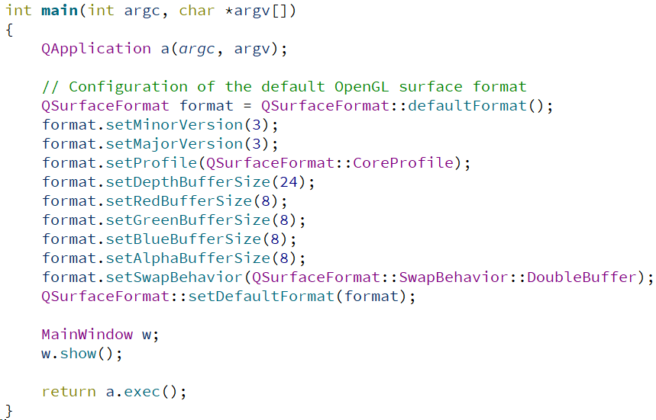
OpenGL initialization (main.cpp)
We will use OpenGL 3.3 Core profile.
There are newer OpenGL versions, but the core basics remain the same since 3.3.
We don’t use the compatibility profile to avoid calling deprecated OpenGL functions.

Slide 4
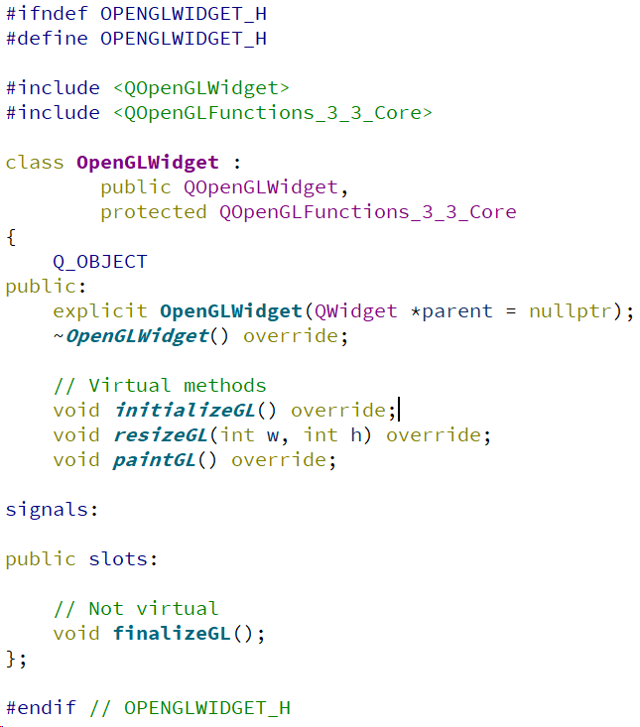
OpenGL initialization (openglwidget.h)
We inherit from QOpenGLFunctions_3_3_Core to have available all functions of Opengl 3.3 Core Profile
We override these three methods to initialize our OpenGL stuff, handle resizing, and updating each frame of our application
This is a function created by us, will be called manually to destroy OpenGL objects (mainly vertex buffers and textures)

Slide 5
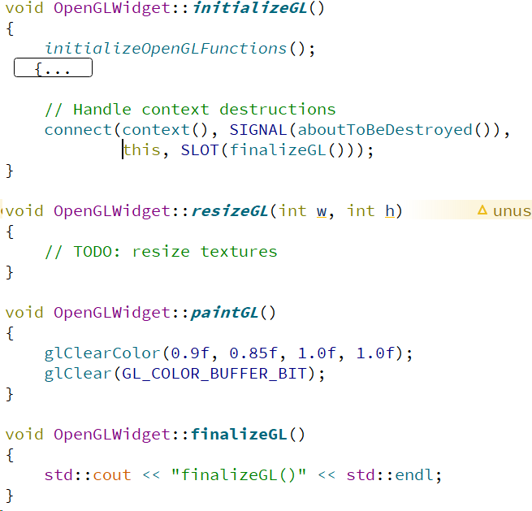
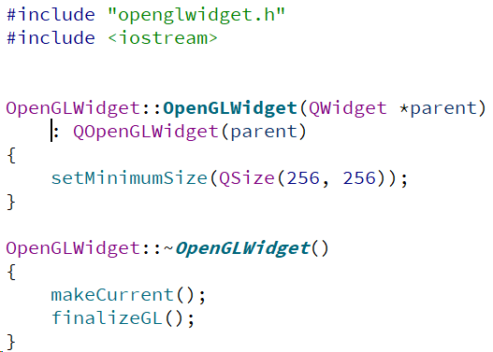
OpenGL initialization (openglwidget.cpp)
Initialize OpenGL functions
Finalize our OpenGL stuff

Slide 6
Retrieving OpenGL information

Slide 7
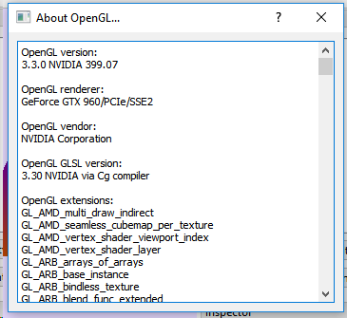
Retrieving OpenGL information
With Qt, create a new dialog showing basic information about the OpenGL context.
You could open this dialog from a menu action (e.g. Help > About OpenGL).
Notice that to recover OpenGL information you will need to execute OpenGL calls. These can only be done when the OpenGL context is active (e.g. within initializeGL(), paintGL(), after executing OpenGLWidget’s makeCurrent(), etc).

Slide 8
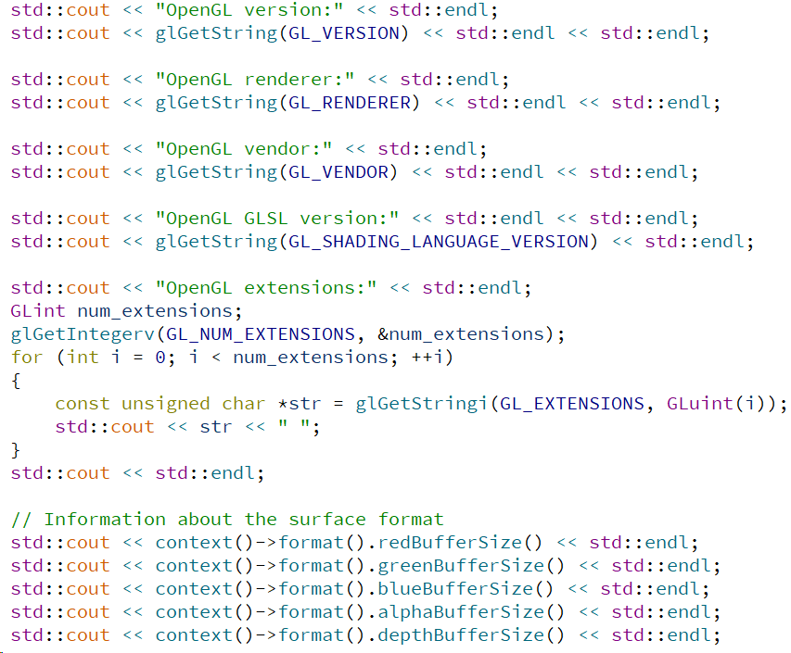
Retrieving OpenGL information
With Qt, create a new dialog showing basic information about the OpenGL context.
You could open this dialog from a menu action (e.g. Help > About OpenGL).
Notice that to recover OpenGL information you will need to execute OpenGL calls. These can only be done when the OpenGL context is active (e.g. within initializeGL(), paintGL(), after executing OpenGLWidget’s makeCurrent(), etc).

Slide 9
Let’s paint a triangle

Slide 10
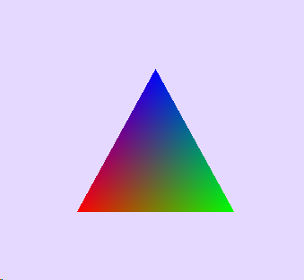

Let’s paint a triangle
To paint this triangle we will need to prepare some stuff:
A vertex buffer object (an array in the GPU with the actual data)
A vertex array object (an object in the GPU with the geometry layout)
A shader program (the algorithm that will position and paint the triangle)
Qt provides three classes to handle these objects

Slide 11
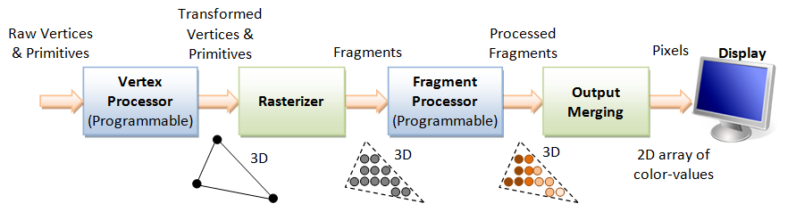
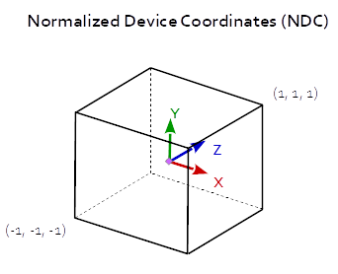
Let’s paint a triangle
When we perform the rendering call, the following pipeline will execute in the GPU:

Slide 12
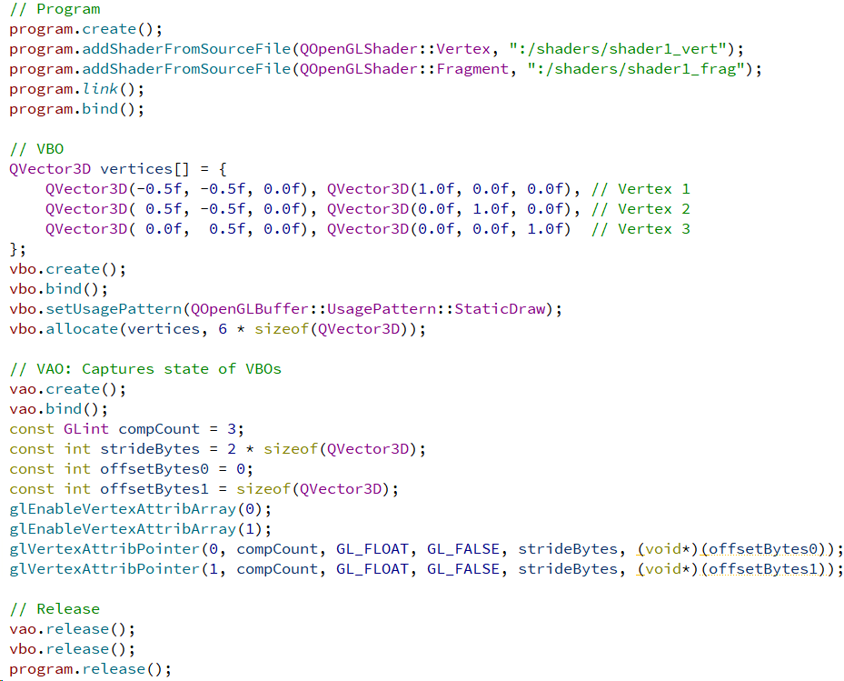
Let’s paint a triangle (initialization of program, VBO, and VAO)
Shader program creation and setup
Positions
Colors
Vertex buffer object (geometry data) creation and data upload
Only for drawing
Vertex array offset creation and setup. VAOs, when created, remember the configuration of bound VBOs and attribute layout…
Next time we bind a VAO, triangle meshes will be ready to be drawn.

Slide 13
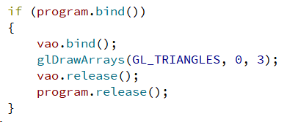
Let’s paint a triangle (render code)
Ready to use the shader program
We are going to use the geometry uploaded before.
Recall that VAOs remember the configuration of bound VBOs and attribute layout when the VAO was bound for the first time.
From the bound VAO, render 3 vertices (interpreted as triangles) starting from the first vertex.
Stop using the VAO and the shader program for now...

Slide 14
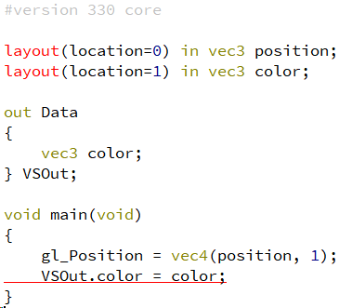
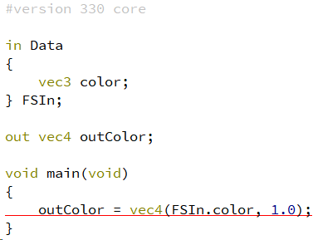
Let’s paint a triangle (GLSL code)
Vertex shader (VS)
Fragment shader (FS)
Input vertex attributes
(from VAO)
Input data
(comes from the VS)
Output data
(will travel to FS)
Output color (will be the fragment color)
We leave the position as-is
&
Forward the color attribute to the FS
We set the output color with the color coming from the VS
The VS sets the vertex position and can forward data to the FS.
The FS computes the final color of the rasterized fragment.

Slide 15
Qt OpenGL tools

Slide 16
Qt OpenGL classes
As you have seen, Qt provides abstraction classes to ease OpenGL workflow:
QOpenGLFunctions_3_3_Core
QOpenGLBuffer
QOpenGLVertexArrayObject
QOpenGLShaderProgram
QOpenGLTexture
QOpenGLFramebufferObject
QVector3D
QMatrix4x4
...

Slide 17
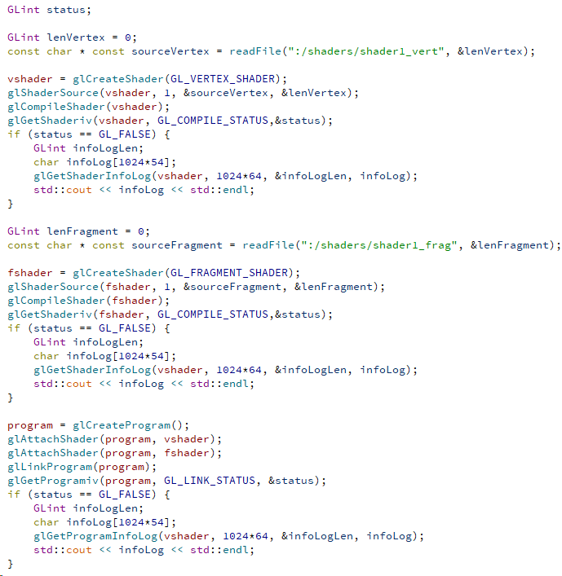

Qt OpenGL vs. standard OpenGL
As you have seen, Qt provides abstraction classes to ease OpenGL workflow:
But you decide whether to use Qt classes or standard OpenGL calls

Slide 18
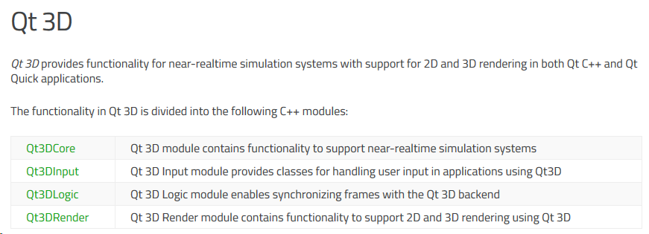
Qt 3D
For a higher level of abstraction, Qt also provides its Qt 3D module
Out of scope in this subject, we will work at a lower level.

Slide 19
Taking screenshots

Slide 20

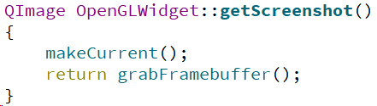
Retrieving OpenGL information
With Qt, create a new action to save OpenGL screenshots.
You could open a QFileDialog from a menu (e.g. File > Save screenshot).
Use the QOpenGLWidget’s function grabFrameBuffer() in order to capture the last image that was rendered. Notice that this call needs to be executed with the OpenGL context being active (so we execute makeCurrent()).

